Slide 1
Programming with C and Python For Newbies
Day 8:Variables, Conditions in Python:
if, elif and else statements

Slide 2
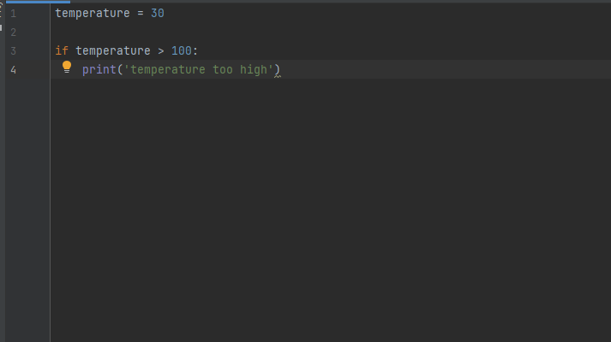
If statement
This allows you to execute a block of code only if a specified condition is true
Syntax

Slide 3
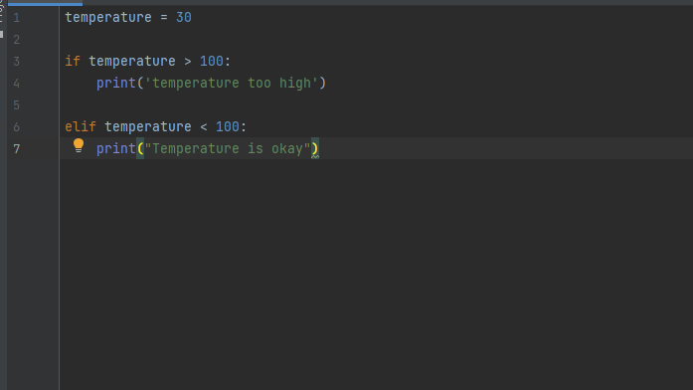
elIf statement
This allows us to test multiple conditions in python
If the first if condition is not true it then checks the next condition which is the “elif” and so on.
Syntax

Slide 4
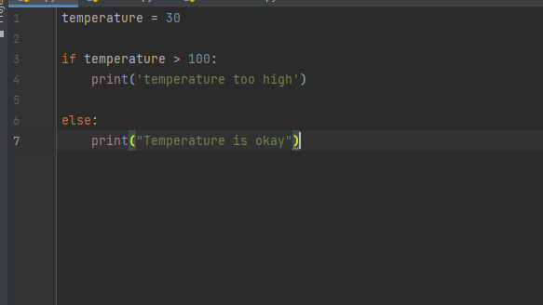
Else statement
This is executed when none of the previous conditions are met.
Syntax

